Slide 1
Lab 6: Design finite state machine

Slide 2
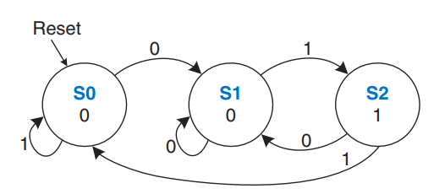
What is finite state machine?
A Finite State Machine (FSM) is a computational model used to design systems that transition through
a predefined set of states based on inputs.
Key Concepts of a Finite State Machine:
States: An FSM consists of a finite number of states. Each state represents a unique condition or configuration of the system.
Transitions: define the rules for moving from one state to another.
Transitions are triggered by inputs (events or signals) and often depend on both the current state and the input values.
A finite state machine
Inputs: Inputs are external signals or events that influence the FSM's transitions and determine its behavior.
Outputs: are signals or actions produced by the FSM.
Outputs can either depend solely on the current state (Moore FSM) or on both the current state and inputs (Mealy FSM).

Slide 3
How to design FSM using SystemVerilog?
Finite state machine consists of:
- Two blocks of combinational circuit: next state logic and output logic
+ Next state logic: determine next state base on current state and current inputs.
+ Output logic:
Moore machines: outputs depend only on current state of machine.
Mealy machines: outputs depend on both current state of machine and current inputs.
- Sequential circuit: Register that store current states, on every clock cycle register moves from current state to next state.
Notes:
fa

Slide 4
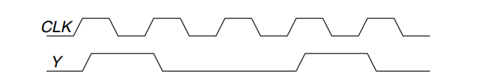
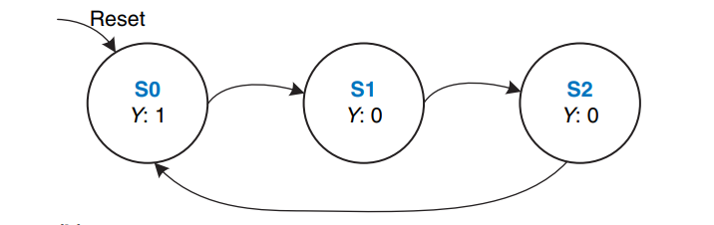
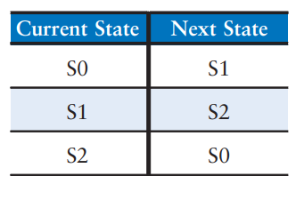
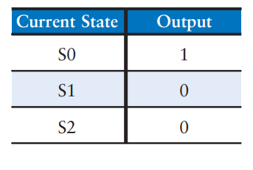
How to design FSM using SystemVerilog?
Step 1: Based on requirements, determine finite state machine
Divide by 3 counter waveform
Divide by 3 counter finite state machine
Step 2: Based on requirements, determine next state table and output table.
Output table
Next state table
Step 3: Design on SystemVerilog
Design next state logic (using next state table) and output logic (using output table) by combinational circuit.
Design register to store current state and update to next state every clock cycle.

Slide 5
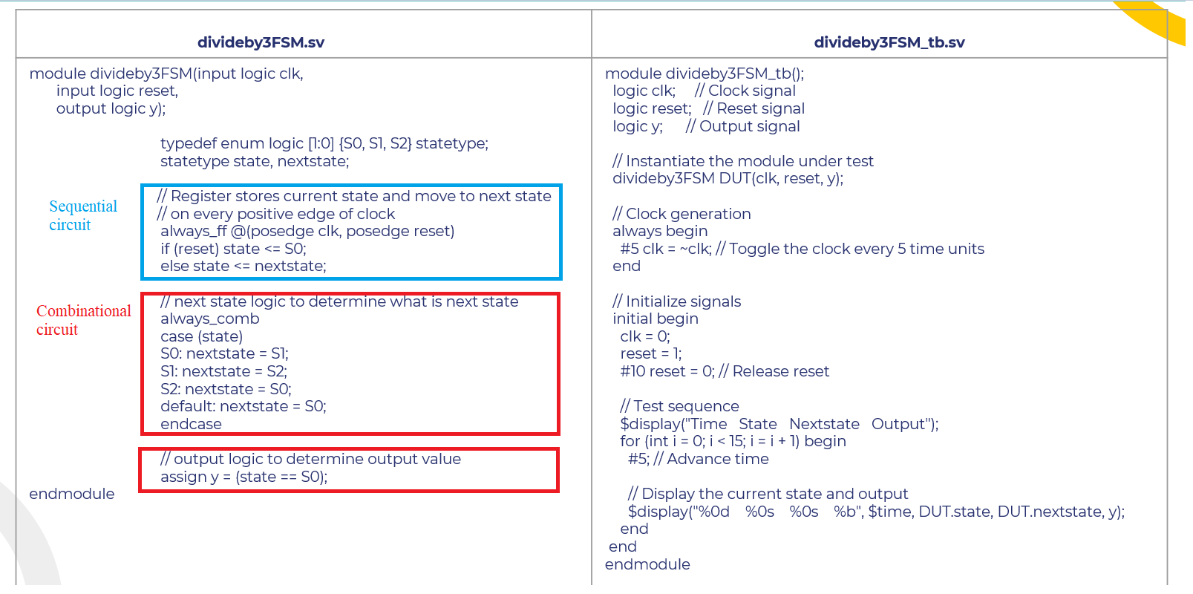
Finite state machine

Slide 6
Finite state machine
divideby3FSM.sv | divideby3FSM_tb.sv
module divideby3FSM(input logic clk, input logic reset, output logic y); typedef enum logic [1:0] {S0 = 2’b00, S1 = 2’b01, S2 = 2’b10} statetype; statetype state, nextstate; // Register stores current state and move to next state // on every positive edge of clock always_ff @(posedge clk, posedge reset) if (reset) state <= S0; else state <= nextstate; // next state logic to determine what is next state always_comb case (state) S0: nextstate = S1; S1: nextstate = S2; S2: nextstate = S0; default: nextstate = S0; endcase // output logic to determine output value assign y = (state == S0); Endmodule | module divideby3FSM_tb(); logic clk; // Clock signal logic reset; // Reset signal logic y; // Output signal // Instantiate the module under test divideby3FSM DUT(clk, reset, y); // Clock generation always begin #5 clk = ~clk; // Toggle the clock every 5 time units end // Initialize signals initial begin clk = 0; reset = 1; #10 reset = 0; // Release reset // Test sequence $display("Time State Nextstate Output"); for (int i = 0; i < 15; i = i + 1) begin #5; // Advance time // Display the current state and output $display("%0d %0s %0s %b", $time, DUT.state, DUT.nextstate, y); end end endmodule

Slide 7
Explain syntax
enum is a user-defined data type used to giving meaningful names to constant values.
enums are often used to improve code readability and maintainability.
Syntax:
typedef enum datatype [bitwidth:0] {
enumerator1 = constant1,
enumerator2 = constant2,
// More enumerators...
} enum_type;
$display is a system function is used for displaying text messages and variable values in a simulation
environment.
Syntax:
$display("format string", expression1, expression2, ...);

Slide 8
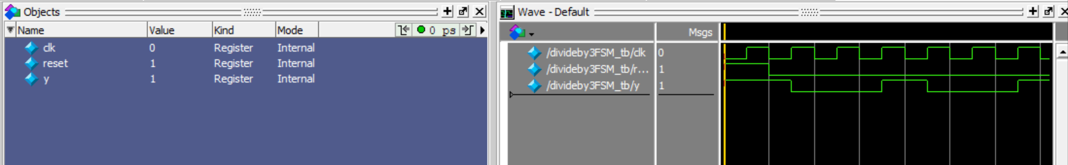
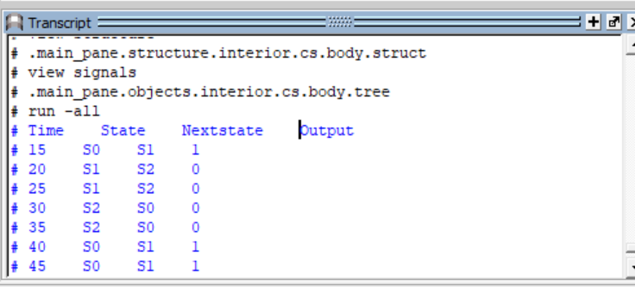
Simulation result

Slide 9
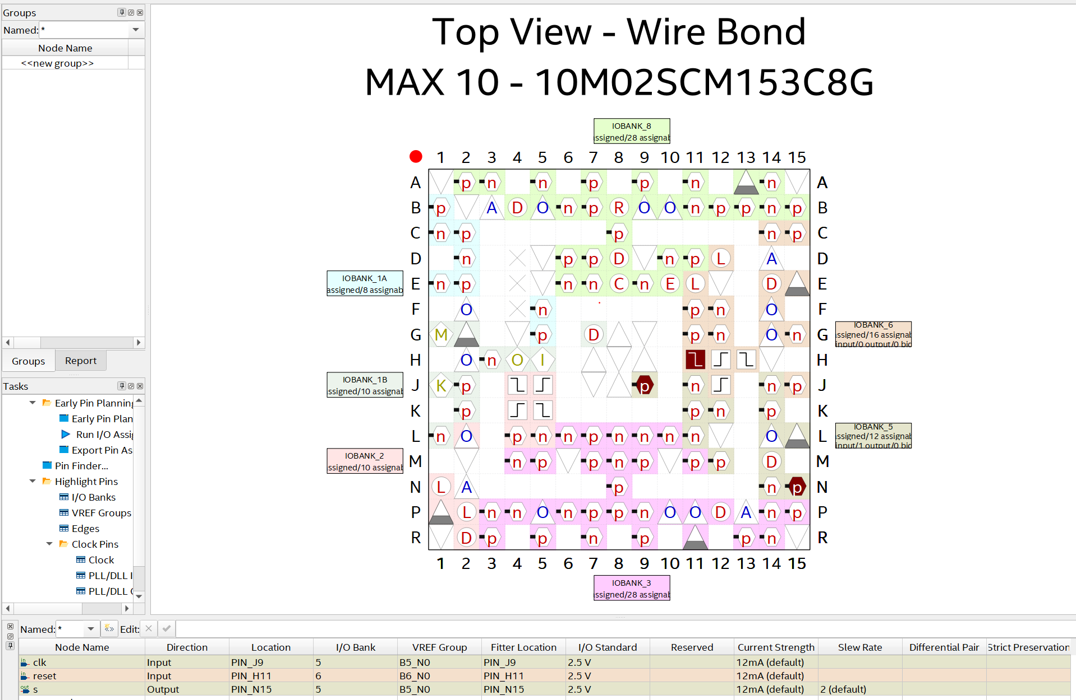
Test design on STEP-MAX 10 board

Slide 10
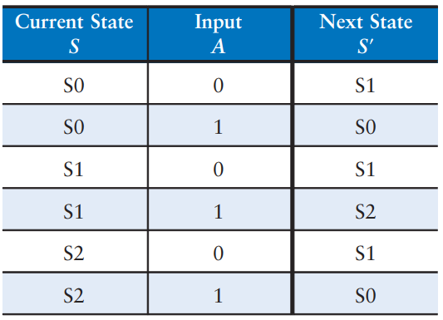
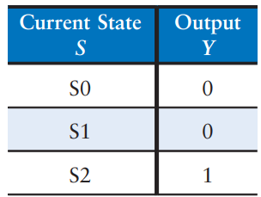
Exercise 1
Design a digital circuit based on following Moore state transition diagram using SystemVerilog and simulate on ModelSim.
Moore machine state transition diagram
Moore next state table
Output table

Slide 11
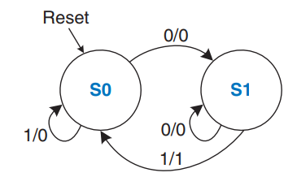
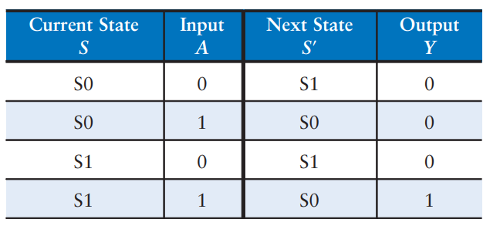
Exercise 2
Design a circuit based on following Mealy state transition diagram using SystemVerilog and simulate on ModelSim.
Mealy machine state transition diagram
Mealy next state and output table

Slide 12
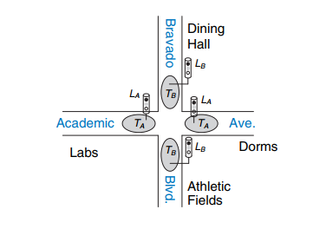
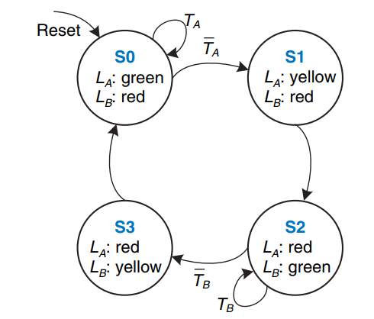
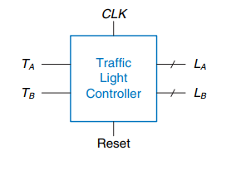
Exercise 3: Traffic light controller
Students move from Labs to Dorms on Academic street.
Football players move from Dining hall to Athletic Fields on Bravado street.
Input: Two traffic sensors, TA and TB. TA indicates true if students are present and false if Academic street is empty. TB indicates true if football player are present and false if Bravado street is empty.
Output: Two traffic lights LA and LB to control traffic. Each lights receives digital inputs to specify whether it should be yellow, red, green.

Slide 13
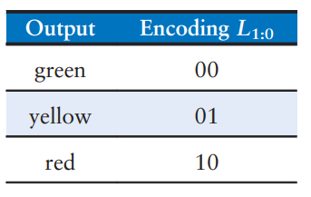
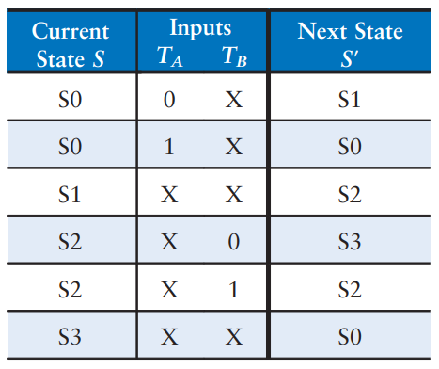
Traffic light controller
Design a light traffic controller digital circuit based on following state transition diagram using SystemVerilog and simulate on ModelSim.
Output encoding
State | Output
S0 | LA: green, LB: red
S1 | LA: yellow, LB: red
S2 | LA: red, LB: green
S3 | LA: red, LB: yellow
Next state table
Output table

Slide 14
Exercise 4: Improved traffic light controller
Accidents are still occurring at the intersection of Academic Avenue and Bravado Boulevard. The football team is rushing into the intersection the moment light B turns green. They are colliding with students who enter into the intersection just before light A turns red. Extend the traffic light controller from previous exercises so that both lights are red for 5 seconds before either light turns green again.
- Sketch your improved Moore machine state transition diagram, next state table, output table .
- Design a digital circuit based on above diagram and tables using SystemVerilog and simulate on ModelSim.

Slide 15
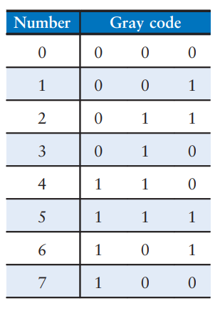
Exercise 5: Modulo 8 counter
Gray codes have a useful property in that consecutive numbers differ in only a single bit position. Below table lists a 3-bit Gray code representing the numbers 0 to 7. Counter has an input signal: Up signal. If UP = 1, the counter advances to the next number. If UP = 0, the counter retreats to the previous number. Design a 3-bit modulo 8 Gray code counter FSM has three outputs as table below:
- Sketch your Moore machine state transition diagram, next state table, output table .
- Design a digital circuit based on above diagram and tables using SystemVerilog and simulate on Modelsim.
(A modulo N counter counts from 0 to N - 1, then repeats with 0.)

